Slide 1


Slide 2
INTERNSHIP REPORT
ON
DATA SCIENCE
Department of computer science and Engineering
PRESENTED BY: SK.T.MASTANVALI (20AR1A0584)

Slide 3
An Internship program submitted in the partial fulfillment of the academic requirements
for the Internship program
ON
DATA SCIENCE
Computer Science And Engineering
Head of the Department Principal
K.PRASADA RAO, M.Tech, PH.D. Dr .A. SUDHIR BABU, M.Tech, PH.D.
Professor Professor

Slide 4
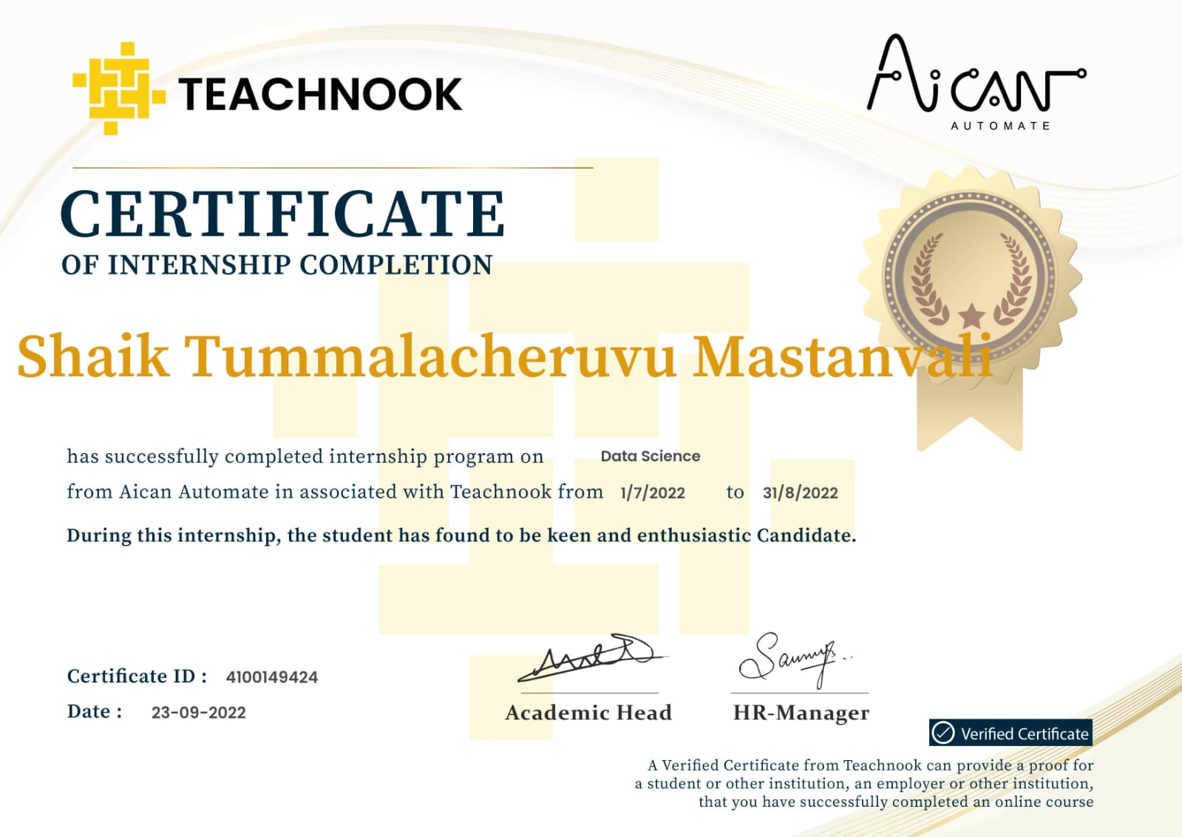

Slide 5
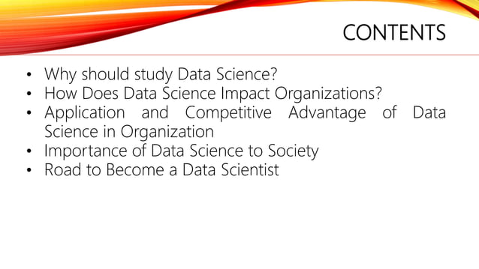

Slide 6
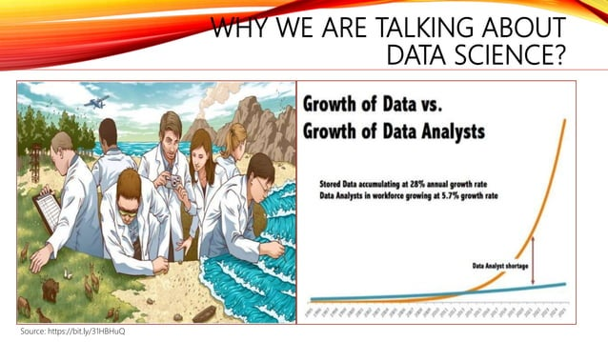

Slide 7
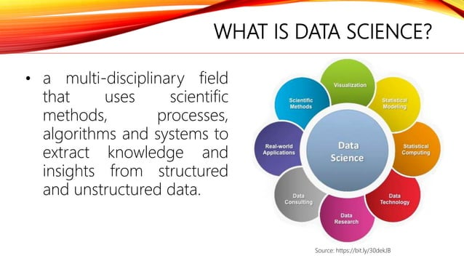

Slide 8
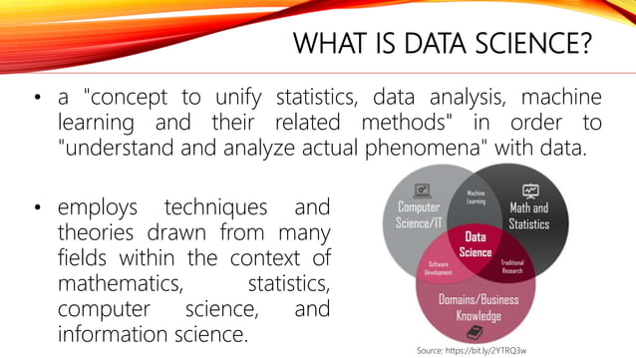

Slide 9
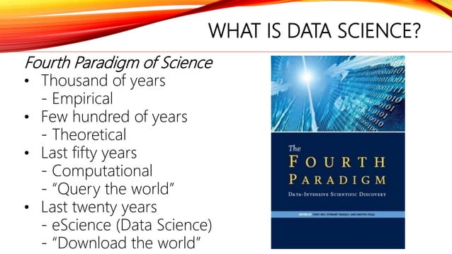

Slide 10
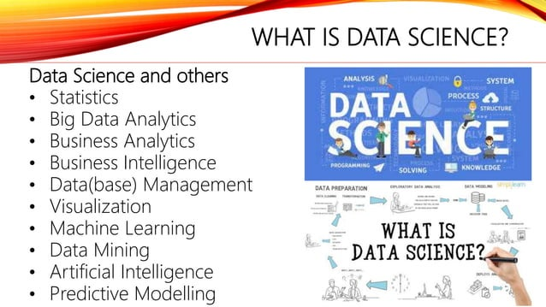

Slide 11
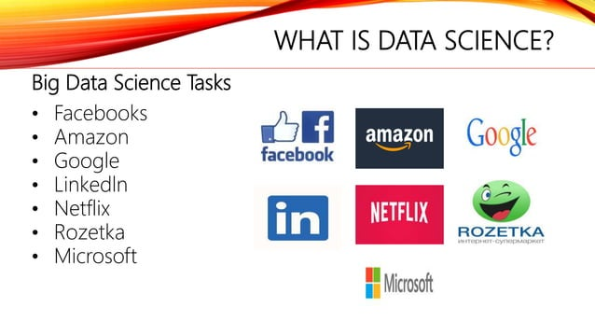

Slide 12
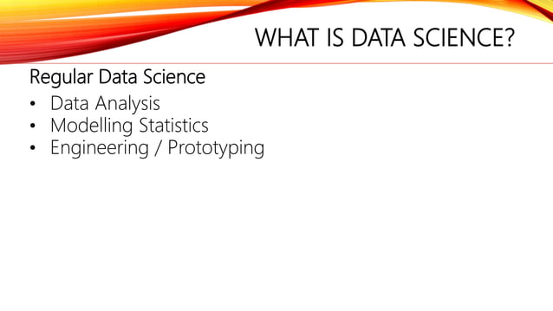

Slide 13
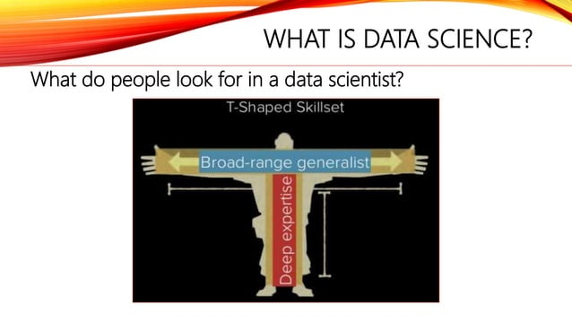

Slide 14
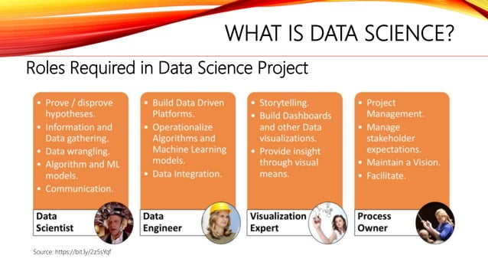

Slide 15
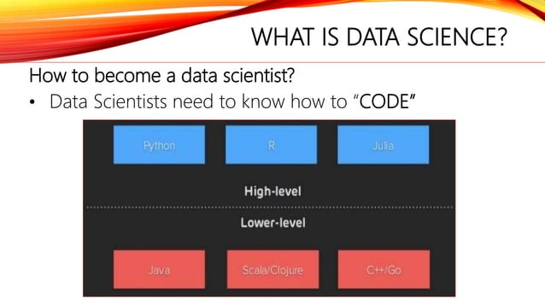

Slide 16
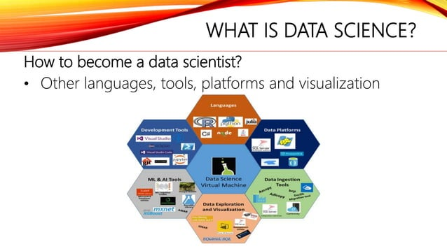

Slide 17
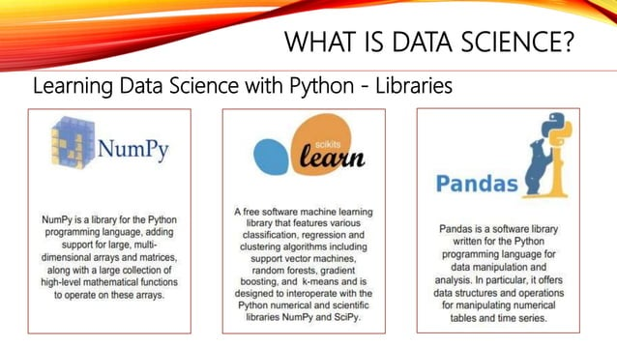

Slide 18


Slide 19
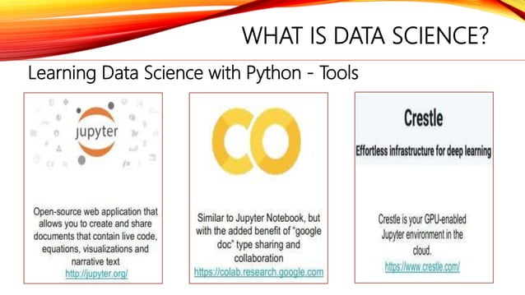

Slide 20
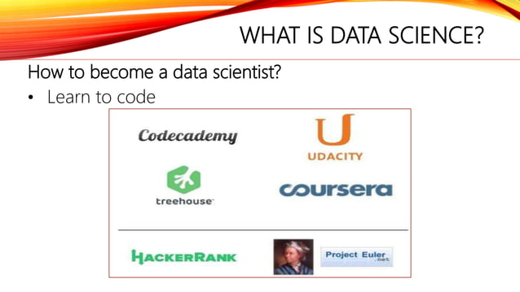

Slide 21
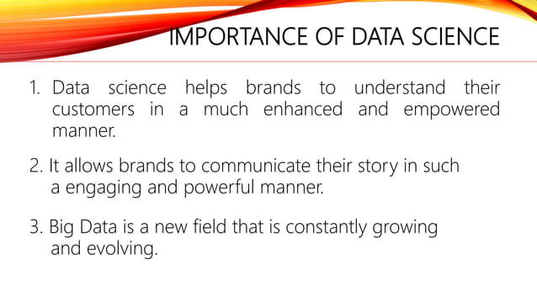

Slide 22
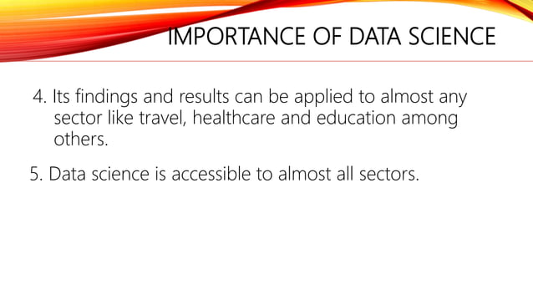

Slide 23
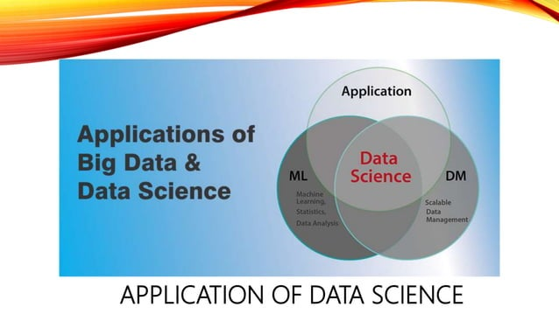

Slide 24
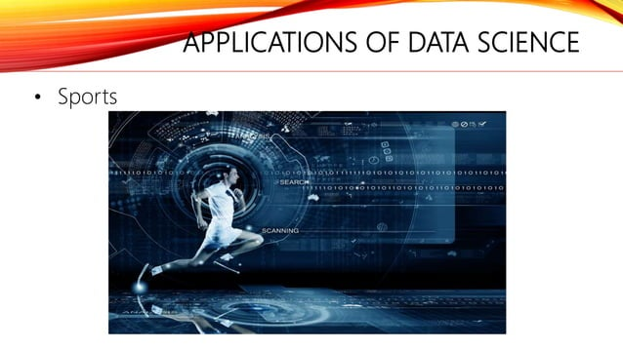

Slide 25
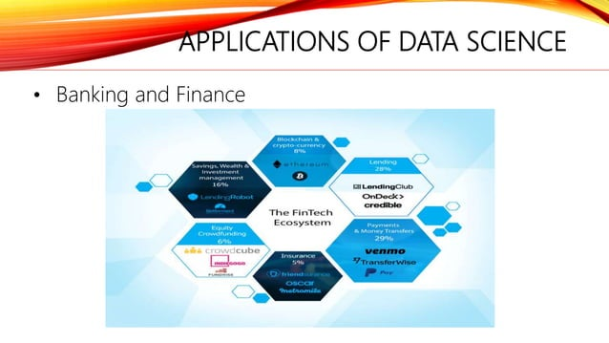

Slide 26
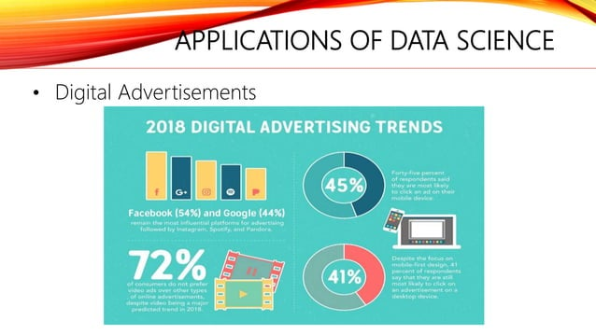

Slide 27
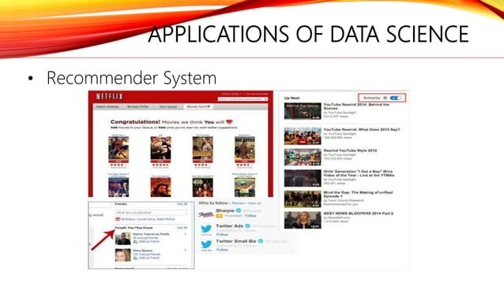

Slide 28
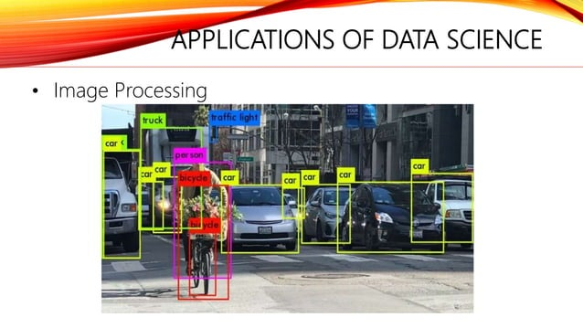

Slide 29


Slide 30
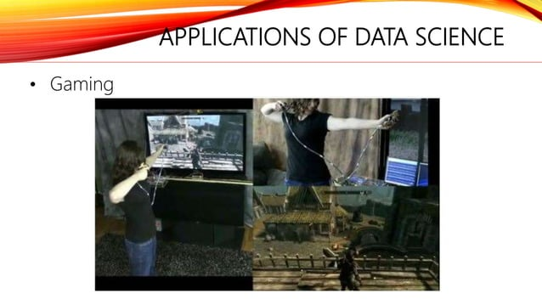

Slide 31
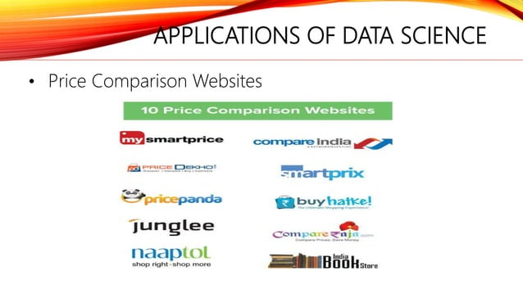

Slide 32
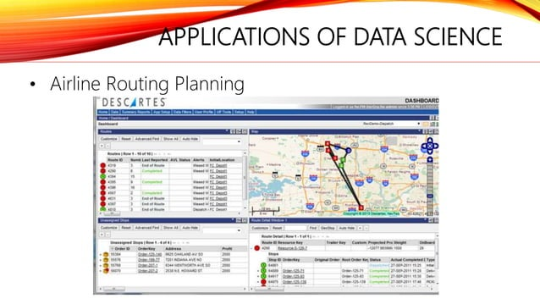

Slide 33


Slide 34


Slide 35
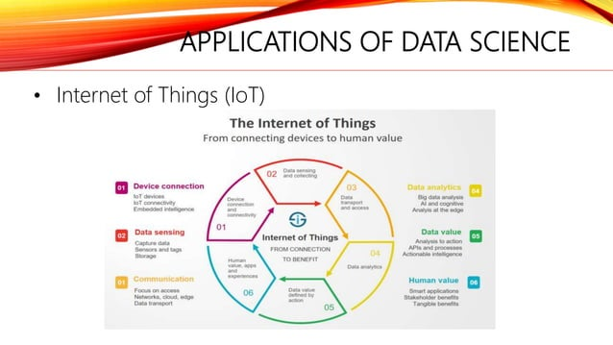

Slide 36
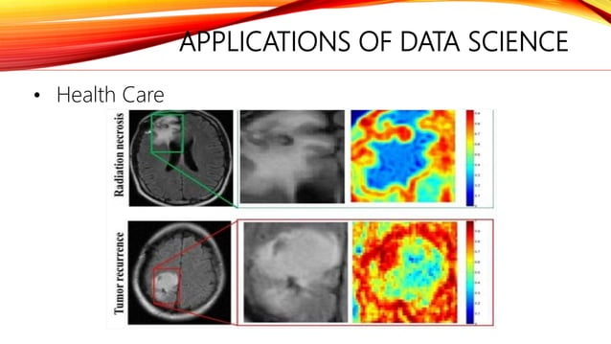

Slide 37
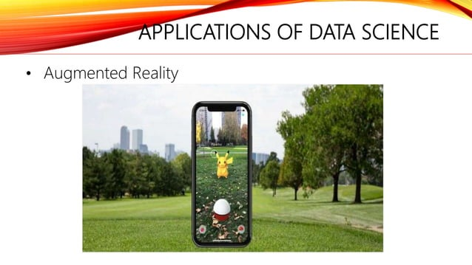

Slide 38
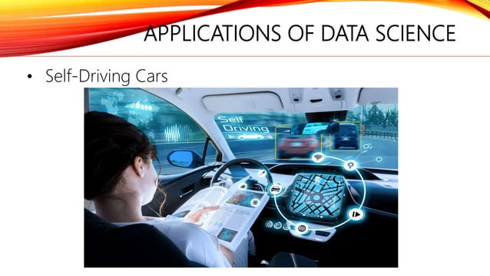

Slide 39


Slide 40


Slide 41


Slide 42


Slide 43


Slide 44
THANK YOU!!

